Slide 1





η-LSTM: Co-Designing Highly-Efficient Large LSTM Training via Exploiting Memory-Saving and Architectural Design Opportunities
Xingyao Zhang^{1,2}, Haojun Xia³, Donglin Zhuang³, Hao Sun³, Xin Fu¹, Michael Taylor², and Shuaiwen Leon Song³
1. ECOMS Lab, University of Houston
2. Bespoke Silicon Group, University of Washington
3. FSA Lab, University of Sydney
(xingyaoz@cs.washington.edu)
Notes:
Hello Everyone, I am Xingyao Zhang, a postdoc scholar at Bespoke Silicon Group from University of Washington. Welcome to our talk on the co-designing highly-efficient large LSTM training through memory-saving and architectural design opportunities. This work is a collaborated work between University of Houston, University of Washington, and University of Sydney.
Comment: can you add my affiliation also with UW (2,3)?

Slide 2
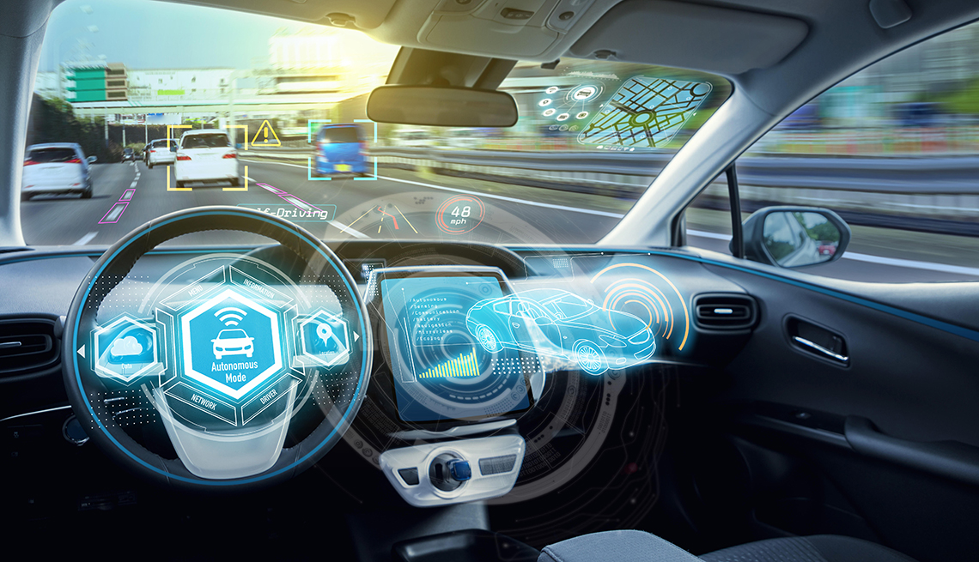




Long-Short Term Memory (LSTM) Networks
Autonomous Driving
Natural Language Processing
Business Processing Management
Medical Diagnosis
Robotic Control
Demands and Data are Dramatically Increasing
LSTM Training Becomes Large
Notes:
One of the most popular types of the recurrent neural networks is long short term memory network, or LSTM. It has been used in many areas related to our daily life.
Although is has been widely-adopted in many fields, in the past the main complaint for adopting the current LSTM models on DNN accelerators is that xxxx.
Currently, the situation is exacerbated when increasing use cases grow the demand and data for LSTM training, forcing LSTM models to become even larger, more complex and harder to train either realtime on-device or offline training.
Comment: demands and data are dramatically increasing ( demands and data? Sounds strange).
LSTM traing becomes large?这个英语好像也不对。 LSTM models become large and more complex? 这两句话要找到合适得说法。

Slide 3
State-of-the-art LSTM Training
GEMM
Element Wise
output
Context
LSTM FW
FW Cell
FW Cell
FW Cell
Unroll
input
Output gradient
GEMM
Element Wise
Context gradient
LSTM BP
BP Cell
BP Cell
BP Cell
Unroll
Input gradient
Notes:
Let’s take a look at how the state-of-the-art training for a LSTM layer is conducted
The LSTM layer should first perform forward execution, which takes the input and generate the output
Different from CNN, it also need the historical output as another input to pass the context information back
Generally, the LSTM FW layer processing can be unrolled into a sequence of the cell processing, w/ each cell takes partial input and context to produce partial output
The cell computation is like this. And these computation can be grouped into two execution kernels: one is the matrix multiplication (GEMM), and the other is the element-wise operations.
On the other hand, the LSTM backpropagation processing can also be unrolled and it takes the exactly reversed computation direction
The computation of a BP cell can also be grouped into a gemm kernel and an element-wise kernel.
Comment: (1) you need to mark forward and backpropagation in the slides or it becomes confusing.

Slide 4

When LSTM is Large
Large LSTM Training
Performance and Energy Efficiency Decreases when xxx
Training becomes increasingly infeasible to be conducted on GPU
NN Machine
Notes:
When LSTM (models?) is large, what will happen for the training performance and energy?
Typically , there are three ways to enlarge the LSTM, increasing the weight size by tuning the hidden size config, or add more layers, or send in longer input sequence to increase the unrolled cell number
We used the state-of-the-art GPU architectures to conduct the characterization. From these figure, when LSTM is large, the performance and energy efficiency will decrease
Also when LSTM is large, training becomes more and more difficult to be performed by a single GPU
With the ever increase LSTM training (ever-increasing LSTM training workload?), NN machine will eventually become very inefficient.
Comment: (1) LSTM is large or LSTM models become large?
我觉得呢你要解释一下这几个图run 再什么hardware 上， 然后你在test 什么 （tflops and energy efficiency), 然后解释完图纸后 （observations), 然后说conlusion: we have observed that performance and energy efficiency significantly decreases when increasing the model size… 有人可能会问 为啥我们不用cluster training 这个？ 你可以then argue on-device training , etc.
Superficial observation. High-level observation. Dosent scale with the increasing

Slide 5
Contribution(1) - Characterization
In addition to parameter and activation, Intermediate variables play an important role
Notes:
To figure out why large LSTM training is so inefficient, we first perform detailed characterization on LSTM execution.
We discover that the element wise computation produces a large amount of the intermediate variables. When only performing inference, you don’t have to care about these.
But when it comes to training, these intermediate variables will need to be stored and loaded back for recomputation during backpropagation. Note that unlike the recomputation strategies presented in the previous works on CNNs and transformers, these intermediate variables cannot be easily recomputed by only storing xxxx (use the sentence in the paper to discuss why they cant use Echo like strategy to store and recompute. This is quite important. Don’t have to be long but need to be said here !!)
Comment: in addition to parameter and activation? What is parameter here? Hyper parameters? Parameters and activation xx? Feels like the English is not complete.
Here is an opportunity for you to explain why previous works cant easily address this intermediate variable problem.

Slide 6
Contribution(1) - Characterization
1.08x
4.34x
Intermediate variables caused an average of 1.08x/4.34x more data movement compared to parameter and activations, respectively.
Intermediate variables occupy an average of 47.18% (up to 74.01%) of the total memory footprint.
Notes:
To quantify the impact of intermediate variables, we evaluate both the data movements and memory footprint breakdown for different LSTM models.
We make two key observations: (1) much more significant data movement caused by intermediate variables than both parameter and activations;
and (2) intermediate variables occupy the major proportion of the total memory footprint. xxxx

Slide 7
Contribution(2) – Software-Level Design Novelty
Cell Level Reduction for Intermediate Variables
BP Layer Length Reduction
Reorder Execution
Trivial BP cells
Data Becomes Sparse
Insignificant BP cells prediction
Compression
Skip Trivial BP cells
Notes:
我总体的感觉是这里其实不用这么说。 因为你后面要解释。 但如果你这么说感觉就very trivial. 不是很impressive.
有一种说法就是你可以这里讲based on our two major observations that xxx and xx, we are able to redesign xxx to xxx so that a more efficient large LSTM training can be enabled. We have designed xxx based execution reordering and leverages xxx to amplify the sparsity in xx stage for effective compression.
For BP layer length reduction, another way to reduce LSTM model size, we leverage an important finding that xxx to design a BP layer length reduction scheme. We will introduce these details in a little bit.
这样说让大家觉得有兴趣听下去， 还会觉得这个work 很又depth. 就不是上来就说我们reorder, spars compression. 基本work 都是这样就显示不出来你的特点。
To address the above issues, we first propose the software level optimizations
We have cell level reduction for intermediate variables,
Basically, we reorder the LSTM training execution at cell level
Then the data between the FW and BP cells become sparse
So we can prune the sparse data afterwards to reduce the intermediate variables
We also have BP layer length reduction,
We find some BP cells have insignificant impact on the weight update,
so we propose to identify those cell
And skip those cells to reduce the data movements towards them

Slide 8
Contribution(3) – Hardware-Level Design Novelty
Omni-PE design for high area efficiency and logic utilization
Intelligent computation resource scheduling
Effective support and interfacing to our software-level design and optimizations
Notes:
这个地方现在太一般了。 需要讲的时候throw out some key words. 如果你这个地方就想很好的聊omni-PE, 那你就强调omni-pe. 要让大家想听下去。
To form a
We also design an accelerator for LSTM training,
It supports our software optimization
It also includes the omni-PE design to achieve high area efficiency
Finally It contains the intelligent computation resource scheduling

Slide 9
Outline
Introduction and Motivation
Software-Level Design and Optimizations
Cell Level Reduction for Intermediate Variables
BP Layer Length Reduction
Hardware-Level Design and Optimizations
Evaluation
Related Work
Conclusion
Notes:
This is the outline of our talk. Next, I am going to discuss our software- and then hardware design strategies and optimizations; following that, I will demonstrate the key evaluation results and then conclude my talk.

Slide 10
Key Observation I
Dense Data
FW-GEMM
FW-EW
BP-EW
BP-GEMM
Intermediate
FW-GEMM
FW-EW
BP-EW1
BP-EW2
BP-GEMM
Notes:
We have a key observation on the intermediate data.
We find that the intermediate data between the FW cell and BP cell is dense
But some BP element wise computation only requires the data from forward cell

Slide 11
Key Observation I
Dense Data
FW-MatMul
FW-EW
BG-EW
BG-MatMul
FW-MatMul
FW-EW
BG-EW1
BG-EW2
BG-MatMul
BG-EW1
Sparse Data
Notes:
And these part actually generate much sparser data compared to the FW element wise output

Slide 12
Before and After
With execution reordered, more data can be compressed
Notes:
This is the before and after for the data magnitude distribution. We observe that of execution can be reordered, many data can be compressed
这个地方可能还要解释的更清楚一点。 有可能是我前面那个slides读你写的没有很清楚。
这个地方是你这个文章最有意思的之一， 我觉得可以花些时间讲。

Slide 13
Cell Level Reduction for Intermediate Variables
Moving forward partial BP execution (moving partial bp execution from
Backpropogation to forward propagation?)
Applying Zero-Pruning Compression
Skipping BP computation
Notes:
Therefore, our cell level reduction contains
Moving forward partial BP execution that requires only the forward variables.
Applying zero-pruning compression on the those executions and save both value and index into the DRAM
Using index information to skip the computation for the remaining BP processing
第一个地方可能要更清楚一点。 现在问题就是不是很清楚这个过程， 从读者角度来讲。 E.g., in this way, after we reorder the execution, we not only significant cut the datamovement but also reduce the computation.

Slide 14
Outline
Introduction and Motivation
Software Level Optimizations
Cell Level Reduction for Intermediate Variables
BP Layer Length Reduction
Hardware Level Optimization
Evaluation
Related Work
Conclusion
Notes:
In addition to cell level reduction we propose to reduce the BP layer length

Slide 15
Key Observation II
BP Cells
Weight
Single loss
Per-timestamp loss
Importance of the cell computation is different.
Some cells make trivial contribution.
Notes:
We have another key observation that the contribution to cell computation is different across cells. In other words, there are some cells are more important than the others.
From the figure, some cells contribute nearly nothing to the weight update.

Slide 16
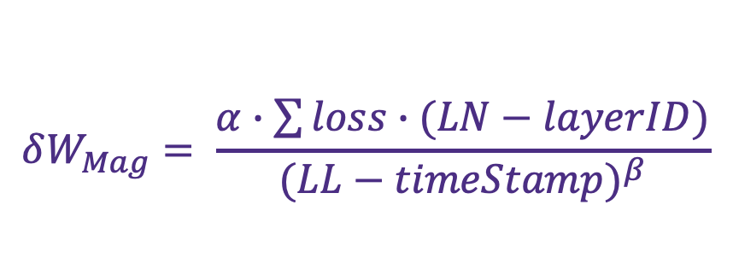
Insignificant BP Cell prediction
Total Layer Number
Current Layer ID
Mag Factor
Threshold
$$δW_{Mag}= \frac{α∙\sum{loss∙(LN−layerID)}}{{(LL−timeStamp)}^{β}}$$
Predict Weight Mag
If Significant?
Loss Type Factor
Total Layer Length
Current Cell Location
Notes:
In order to identify those trivial cells, we build a mathematical model.
Which takes in the LSTM layer config and final loss type into consideration.
With this model, we can set a threshold to determine whether the cell is significant
So this is the diagram for the BP cell skipping
We only need the weight gradients from the significant BP cells
And we further scale the partial results to get the gradients results for entire LSTM layer

Slide 17
Outline
Introduction and Motivation
Software Level Optimizations
Cell Level Reduction for Intermediate Variables
BP Layer Length Reduction
Hardware Level Optimization
Evaluation
Related Work
Conclusion
Notes:
Next, we further propose several hardware-level design and optimizations.

Slide 18
Design Challenges
Workload
FW cell =
GEMM
+
Element-Wise
GEMM
BP cell =
GEMM
+
Element-Wise
>>
Element-Wise
Multiplier +
Accumulator
Multiplier +
Adder +
Activation Function Unit
If putting into separate modules, logic utilization for element-wise module becomes low
If designing PEs enable both kernels ➔ Large area overhead
Inefficient for fast data consumption
between two kernels
Notes:
The hardware design should be sticked with the computation
Based on our previous discussion, the computation of FW cell and BP cell can be divided into gemm and element-wise kernels.
However, these two kernels perform different computations. Note that the accumulator and adder are actually different in terms of the logic design
Besides, these two kernels have different workload. Which is gemm much larger than element-wise
So the problem is that if we put these two kernels into separate modules, which is actually popular for LSTM inference accelerator design, the element-wise kernel will be in idle for the most of the time
But if we conduct the naïve design to put all things into same PE sets, then the PE design will be complicated and area inefficient.
Besides, such design require one kernel finished before another kernel is executed, just like GPU, so the intermediate data between these two kernel may need to be stored into DRAM, which induce data movement overhead

Slide 19
Opportunity – Adder-Based Accumulator
Problem: Adder has latency to produce results, causing stalls during accumulation.
Solution: By appending a buffer after the adder, it can act like an accumulator to perform streaming accumulation.
Notes:
Luckly we find an opportunity to use adder to perform streaming processing of accumulation
So previous problem is that adder has latency to produce results. If we perform A+B+C+… we need to wait for A+B’s result then calculate +C
We propose to append a buffer or a queue after the adder, and control the execution flow to form the streaming processing like the way illustrated in the table

Slide 20
η-LSTM Architecture with Omni-PE
Omni-PE: Enable Multiply, Add, and Accumulation
Omni-PE
Channel: Omni-PEs + Activation Module
η-LSTM Architecture:
Dynamic channel function swing
Support computation Skip
η-LSTM Architecture
Notes:
This is our Omni-PE design, which enables multiply, add, and accumulation (? 这个地方是说一个PE 都能 enable 这些吗？ 以前没有这么做的吗？0
We have channels to hold multiple PEs and activation module
This is our entire accelerator architecture.
Specifically, we have customized controller to enable dynamic channel function swing. So different channels could perform different kernels based on demand. All the computation resource can be leveraged and the intermediate data can be fast consumed as well.
We also customized our DMA to support the computation skipping from our software optimizations

Slide 21
Outline
Introduction and Motivation
Software Level Optimizations
Cell Level Reduction for Intermediate Variables
BP Layer Length Reduction
Hardware Level Optimization
Evaluation
Related Work
Conclusion
Notes:
I have talked about our optimizations, it is the time to show how effective they are.

Slide 22
Experimental Setup
GPU - Nvidia Tesla V100 (Baseline and Software Implementation)
5,120 Shading Units @ 1230MHz
L1 cache/ Shared Memory: 128KB * 80
Default Memory: 32GB HBM w/ 897GB/s Bandwidth
Accelerator Implementation – Xilinx Vertex-UltraScale+ HBM VCU128 FPGA Evaluation Board
2,852K System Logic Cells
9,024 DSP Slices
Memory: 8GB HBM w/ 224GB/s Bandwidth (only use 40 channels)
Benchmark
Name | Abbr.
TREC-10 | Question Segmentation
PTB | Language Modeling
IMDB | Sentiment Analysis
Name | Abbr.
WAYMO | Autonomous Driving
WMT | Machine Translation
BABI | Question Answering
Notes:
We used the latest GPU to conduct the baseline case and the pure software implementation
Our hardware design was performed on the Xilinx VCU 128 FPGA board
We evaluated six most popular LSTM benchmark

Slide 23
Improvement on Performance Speedup
Software Level Optimization achieves an average of 1.56x Speedup
Hardware Level Optimization achieves an average of 1.42x Speedup
Together, η-LSTM achieves an average of 3.99x Speedup
Notes:
This figure shows the effectiveness of our optimizations on the LSTM training.
We observe that our software optimization can achieve 1.56x speedup on GPU
Our Hardware design achieves 1.42x compared with baseline GPU
And combine them, we can achieve 3.99x speedup
这个地方我会也加入up to 在每一个后面。

Slide 24
Energy Savings
Software Level Optimization achieves an average of 1.54x Energy Saving
Hardware Level Optimization achieves an average of 1.67x Energy Saving
Together, η-LSTM achieves on an average of 2.75x Energy Saving
Notes:
一样我会加个up to . 我其实觉得各种有颜色也不太用。 感觉有点乱。 就是重要结果画红色就好。
Our optimizations also achieve great improvement for energy.
Our software level optimizations achieves 1.54x on energy saving
Our Hardware level optimizations achieves 1.67x on energy saving
Together, the n-LSTM achieve 2.75x on energy saving

Slide 25
Improvement on Data Movement
TREC10
PTB
IMDB
WAYMO
WMT
BABI
η-LSTM’s software-level design can significantly reduce the data movement for weights, activations, and intermediate variables.
Notes:
These figures show that Our eta_lstm can effectively reduce the data movement for weights , activations, and intermediate variable

Slide 26
Improvement on Memory Footprint
TREC10
PTB
IMDB
WAYMO
WMT
BABI
Our η-LSTM can also effectively reduce the Memory Footprint for Activations and Intermediate variables.
Notes:
We further evaluate the eta-LSTM impact on the memory footprint. As shown in this figure, activation data and intermediate variables get reduced a lot

Slide 27
Related Work
Neural Network Acceleration
CNN Training Optimization
LSTM Inference Optimization
Memory Footprint Reduction
Weight Matrix Encoding
Re-computation
η-LSTM is the first work aims to enable highly efficient large LSTM training by leveraging several unique LSTM training features to drastically reduce memory footprint and data movement.
Notes:
这个slides 问题最大。
你如果放在这里的话就要把所有那些paper refs加上去， [xxx, micro’19][xxx, isca’20]
There are many works focusing on NN acceleration, But most of them are for CNN and LSTM inference
There are also memory footprint reduction works, they leverage the weight matrix compression and re-computation to address the issue
Our work here is the first work to accelerate the large LSTM training, and leverages UNIQUE LSTM training feature to reduce the memory footprint and data movement.

Slide 28
Conclusion
We conduct a comprehensive characterization study for large LSTM training on state-of-the-art architectures and identify its root causes for training inefficiencies.
At software level, we introduce several key observations regarding the unique LSTM training data patterns, which are then leveraged to enable large reduction on memory footprint, data movements and training latency.
At hardware level, we propose novel architecture designs to enable high logic utilization on customized NPUs, while supporting our software-level optimizations and further enhancing LSTM training performance and energy efficiency.
Our proposed η-LSTM outperforms the baseline GPU by an average of 3.99x on performance and 2.75x on energy consumption.
Notes:
To conclude this talk. Balabala..
Comment: NPS may be added to the previous discussion?
结论最后是不是要也说下和当今的accelerator design 比好多少呢？

Slide 29

η-LSTM: Co-Designing Highly-Efficient Large LSTM Training via Exploiting Memory-Saving and Architectural Design Opportunities
Xingyao Zhang^{1,2}, Haojun Xia³, Donglin Zhuang³, Hao Sun³, Xin Fu¹, Michael Taylor², and Shuaiwen Leon Song³
1. ECOMS Lab, University of Houston
2. Bespoke Silicon Group, University of Washington
3. FSA Lab, University of Sydney
(xingyaoz@cs.washington.edu)

